Slide 1
Train

Slide 2
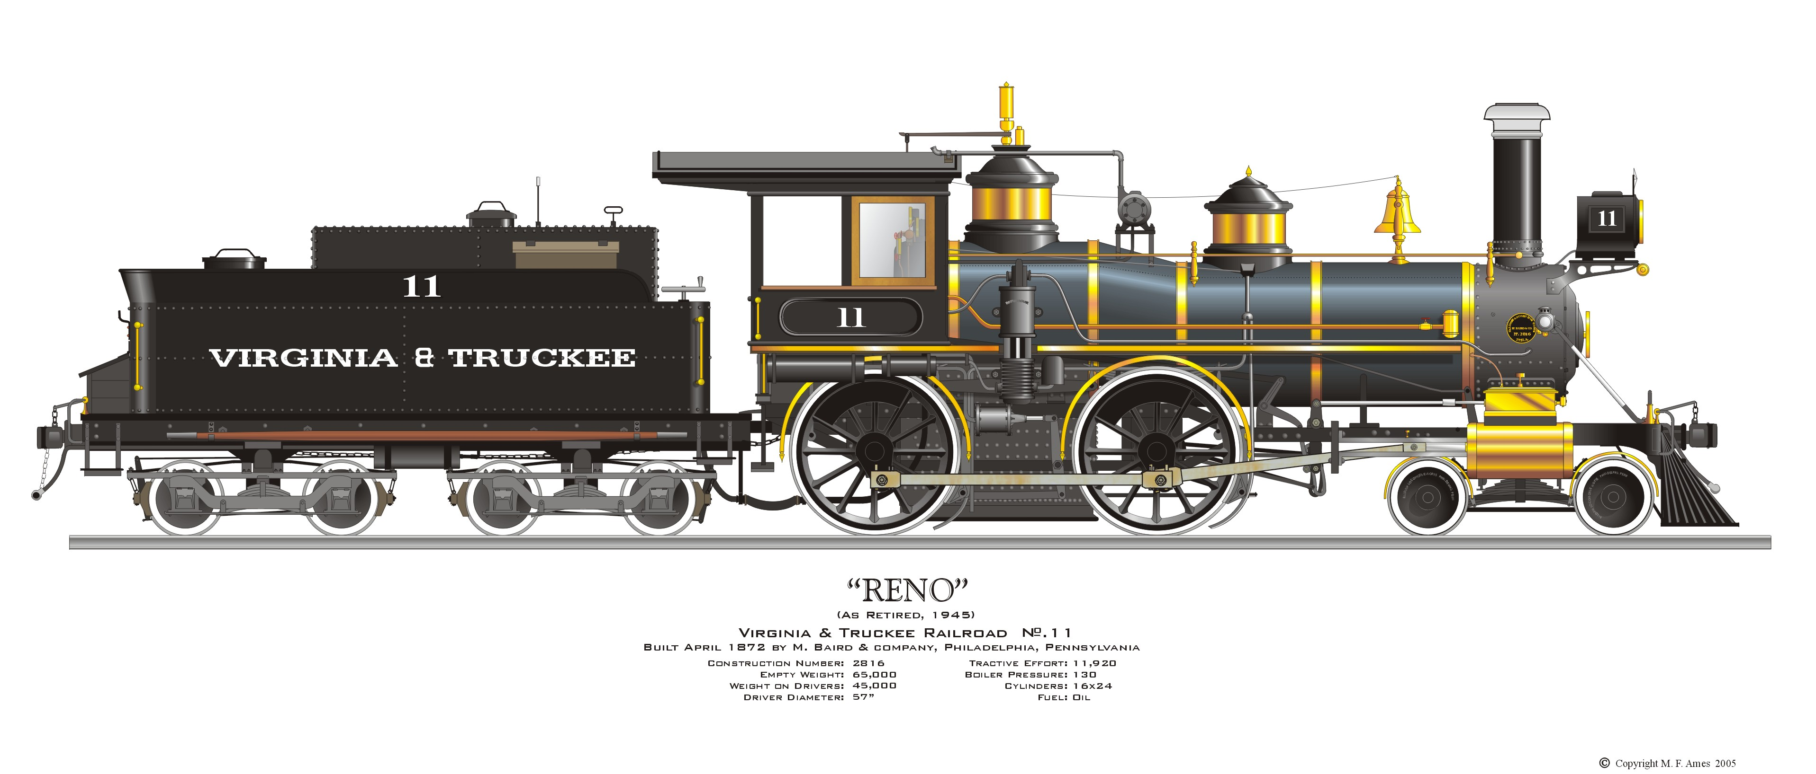
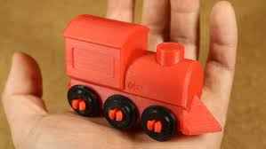
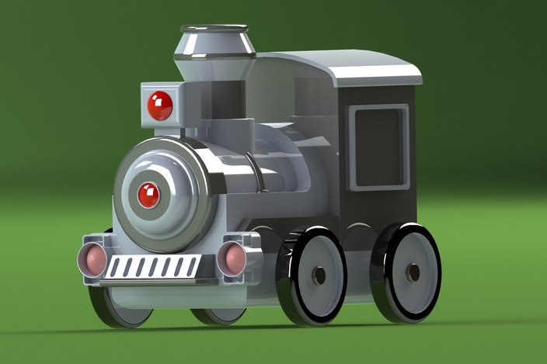

Slide 3
Train
CABIN
h2
ENGINE
h1
BASE
l2
l1
d1
b1
z
height
length
breadth
x
y

Slide 4
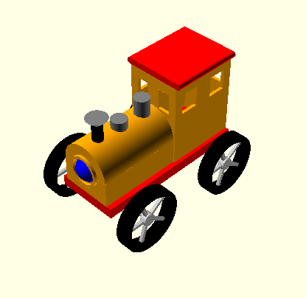
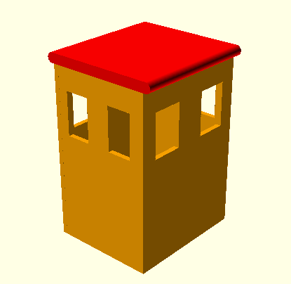

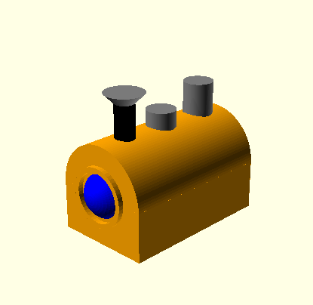
Simple Train
Cabin
Engine
Base
Train.scad
Engine.scad
Cabin.scad
Base.scad

Slide 5
Simple Train
Cabin
Engine
Base
Train.scad
SteamTrain.scad
Copy
Engine.scad
SteamEngine.scad
Cabin.scad
SteamCabin.scad
Base.scad
SteamBase.scad

